Slide 1
Linux Assembly
Armine Hayrapetyan

Slide 2
Outline

Slide 3
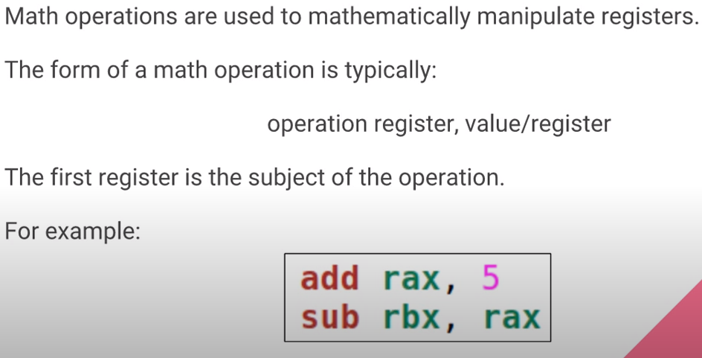

Slide 4
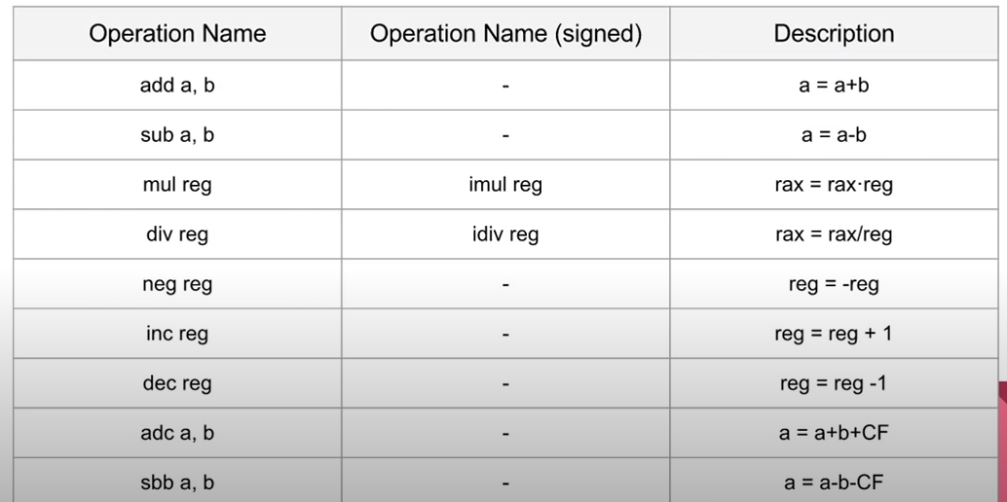
Math Operations List

Slide 5
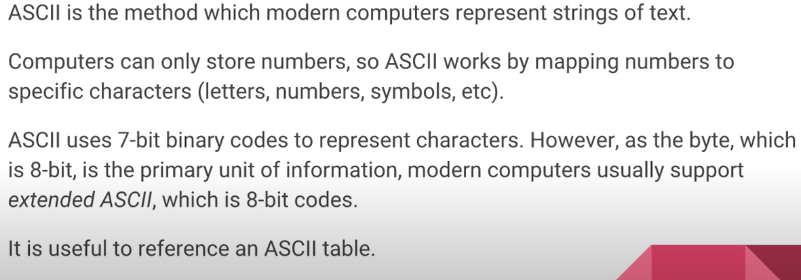
ASCII

Slide 6
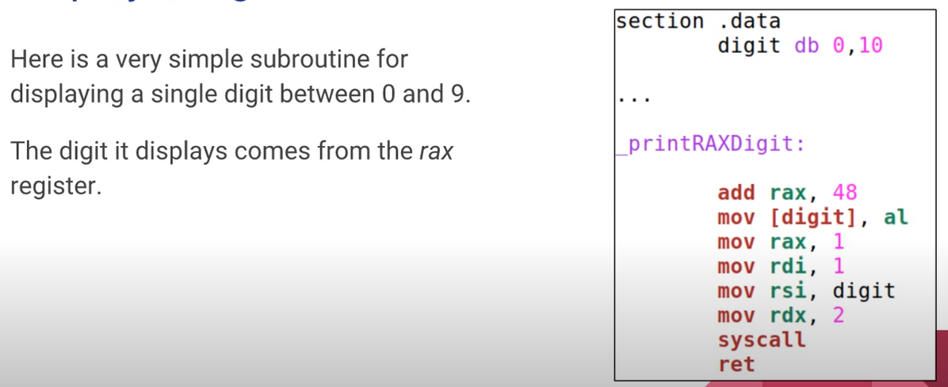
Display a Digit

Slide 7
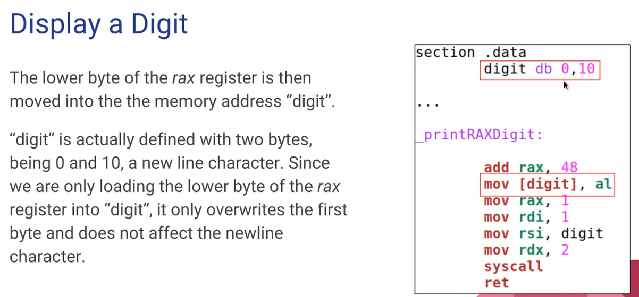

Slide 8
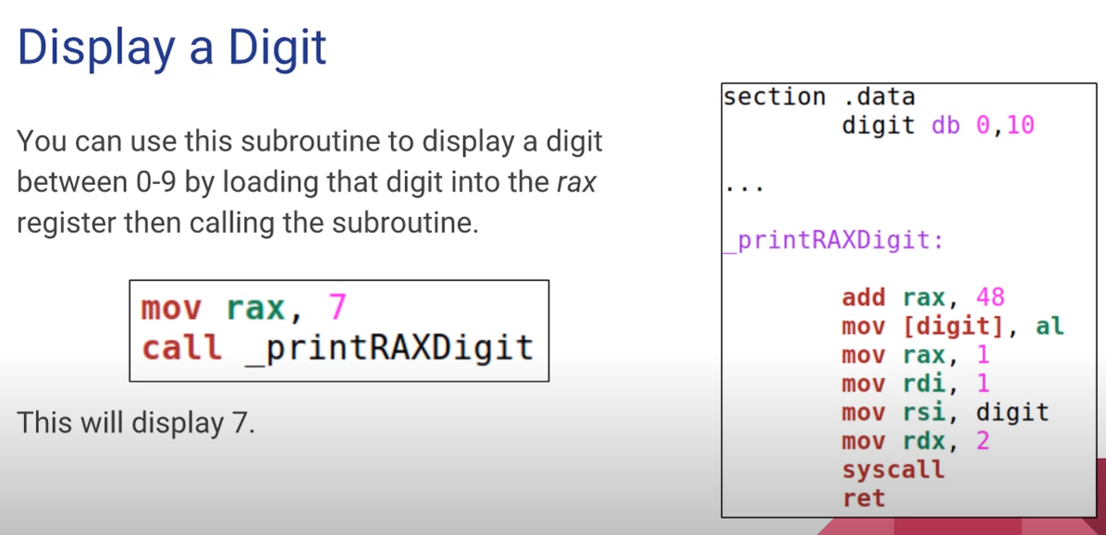

Slide 9
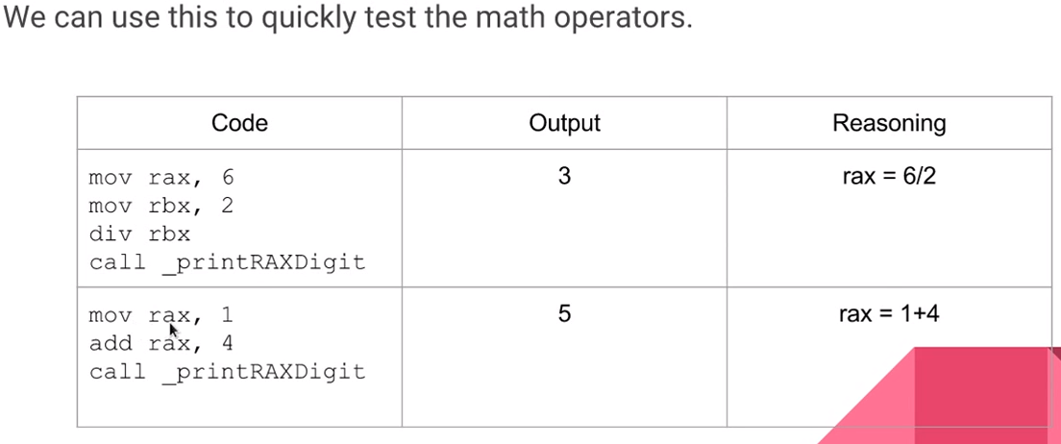
Testing Math

Slide 10
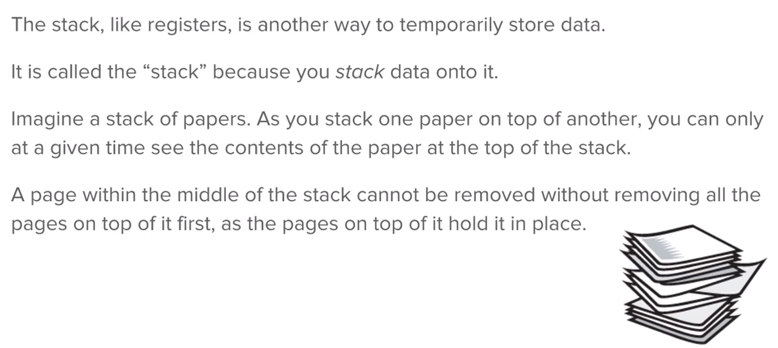
The Stack

Slide 11
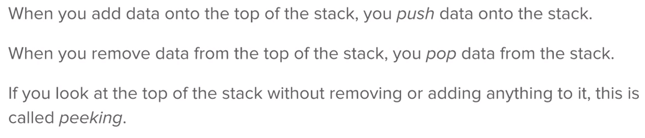
Terminology

Slide 12
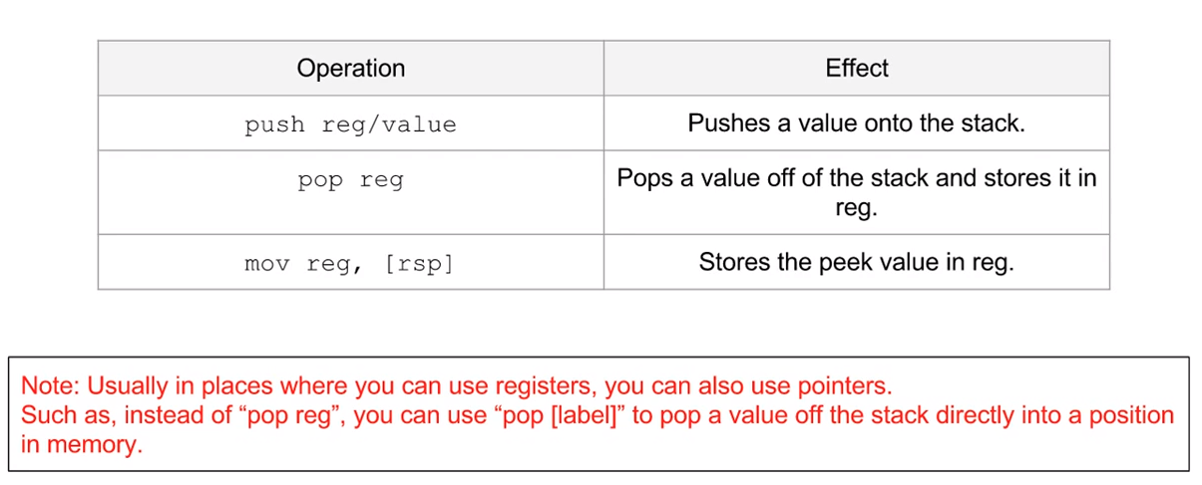
Stack Operations

Slide 13
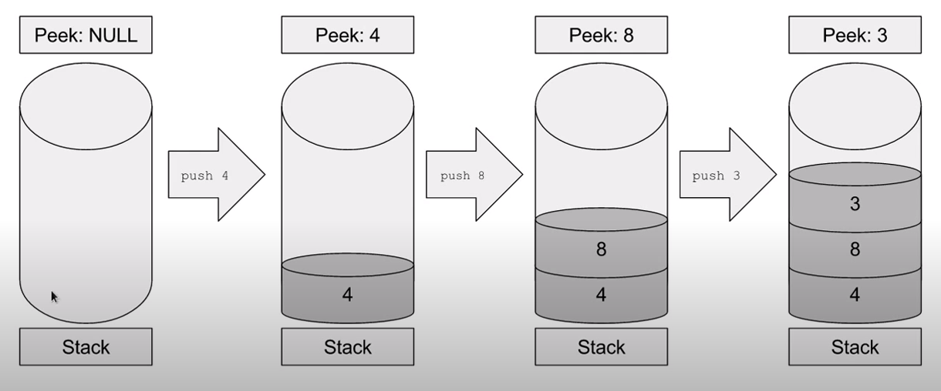
Push

Slide 14
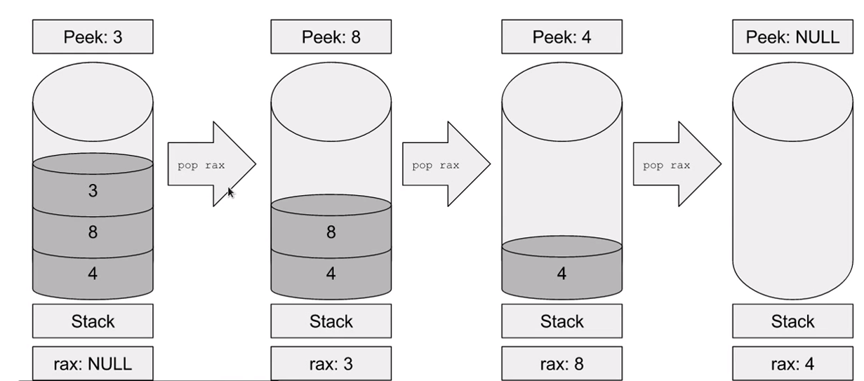
Pop

Slide 15
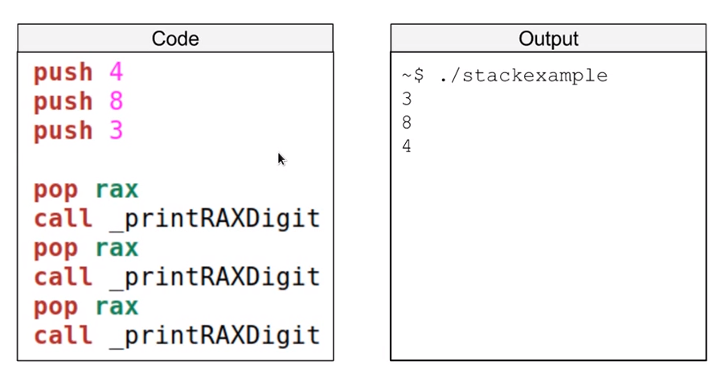
Example Code

Slide 16
References
https://www.youtube.com/watch?v=NFv7l3wQsZ4&list=PLetF-YjXm-sCH6FrTz4AQhfH6INDQvQSn&index=5

